Slide 1
Boni Mchunu – Managing Director ECR

Slide 3
ABOUT - EGTA
EGTA is a trade association body for marketers of advertising solutions
The association has about 166 members across 40 countries
2022 marked the 5th edition of EGTA Study Trip
EGTA offers all participants an opportunity to understand and anticipate the evolutions of media to:
trends and technologies that are shaping radio/audio,
advertising,
podcasting,
music streaming,
on demand audio,
data strategies,
new ad formats and the future of these media platforms from an American perspective

Slide 4
REDISCOVER THE POWER OF RADIO

Slide 10
Misconceptions that brands have about radio

Slide 11
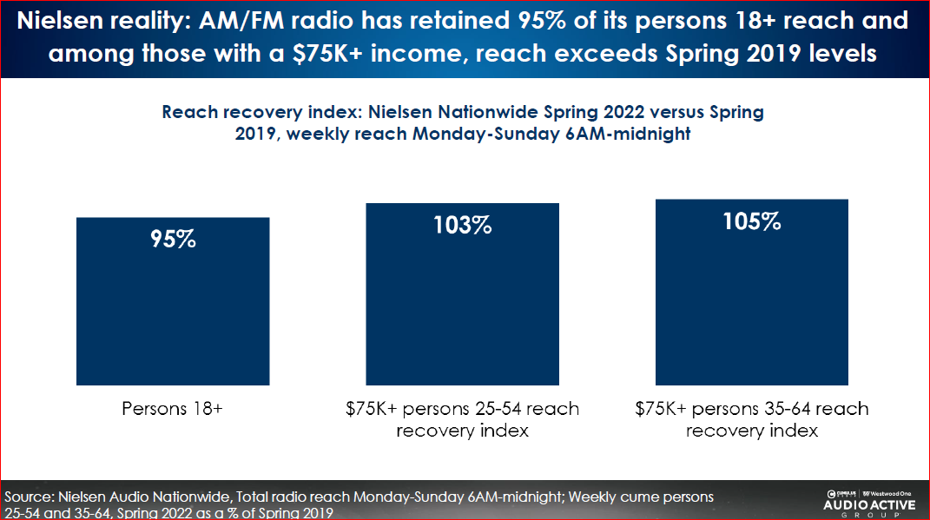
NO ONE LISTENS TO RADIO

Slide 12
EVERYBODY IS WORKING FROM HOME

Slide 13
RADIO HAS A LOW REACH

Slide 14
ARE DIGITAL AUDIENCE SHARE EQUAL TO RADIO

Slide 15
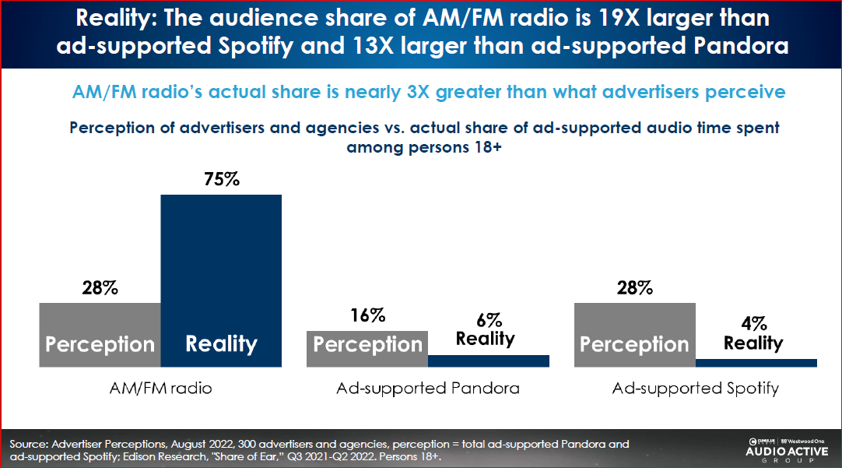
ARE DIGITAL AUDIENCE SHARE EQUAL TO RADIO

Slide 16
RADIO’S STORY TODAY

Slide 17
Radio is a massive reach medium, including those 13-34

Slide 18
HOW ARE PEOPLE LISTENING

Slide 19
Share of Ear
Americans’ 13+ Share
of Time Spent Listening to
Ad-Supported Audio Sources
Streaming Audio
15%
Pandora Free
5%
AM/FM Radio
72%
Spotify Free
5%
Other
5%
Podcasts 13%
Streaming Audio excludes pure plays from Pandora One & Spotify Premium
Edison Research Share of Ear Q4 2021 & Q1-Q3 2022

Slide 20
Significant Digital Growth Stories for Spotify, Podcasts, YouTube among 13+
2% in 2014
to
8% in 2022
2% in 2014
to
6% in 2022
5% in 2014
to
14% in 2022
Spotify
Podcasts
YouTube
YouTube for music and music videos only Edison Research Share of Ear ® 2014 - 2022

Slide 21
Americans now spend more time with audio through mobile device than a traditional radio receiver
Share of all audio listening that occurs on device
AM/FM Radio Receiver
49
47
46
43
41
41
35
33
33,3
32
33,1
30
25
27
21
23
18
Mobile Device
20
2014
2015
2016
2017
2018
2019
2020
2021
2022
Includes all audio sources. AM/FM Radio includes over the air and radio streams Edison Research Share of Ear ® 2014-2022

Slide 22
TVs are now a source of audio consumption
Americans’ Audio Listening by Device
SiriusXM
Receiver
Internet-
AM/FM Radio Receiver
Mobile Device
Smart Speaker
Connected
Computer
TV
TV
Other
11
5
5
4
5
4
Total
33
33
19
13
2
5
3
7
3
13-34
48
9
6
5
4
5
4
35-54
33
34
14
9
8
5
4
3
5
55+
52
YouTube for music and music videos only
AM/FM Radio includes over the air and radio streams
Streaming Audio includes pure plays such as Pandora, Spotify, and others
Edison Research Share of Ear ®Q3 2022

Slide 23
LISTENERS ARE BUYING MEDIA

Slide 24
Radio is a massive reach medium including those of age 13-34 daily @ 58%
Total
65%
13-34
58%
35-54
70%
55+
67%
% daily cume to AM/FM Radio
AM/FM Radio includes over the air and radio streams
Edison Research Share of Ear Q4 2021 & Q1-Q3 2022

Slide 25
PODCASTS TSL AMONGST 13+ IS GROWING

Slide 27
SETTING THE RECORD STRAIGHT

Slide 28
