Slide 1


Compliance issues for Broadcasters
Julia Sham-Guild
Head of Legal and Regulatory Affairs

Slide 2


Context & Agenda
  The legislation and regulations that guide Community Broadcasting Services in South Africa
  Electronic Communications Act
  ICASA Act
  Community Broadcasting Services Regulations
  Digital Sound Broadcasting Services Regulations
  Current ITP-R
2

Slide 3
Electronic Communications Act
‘community’ includes a geographically founded community or any group of persons or sector of the public having a specific, ascertainable common interest
‘community broadcasting service’ is an entity that
  is fully controlled by a non-profit entity and carried on for non-profit purposes
  serves a particular community
  encourages members of the community to participate in programme selection
  is funded by donations, grants, sponsorships or advertising, or membership fees, or by any combination
3

Slide 4
Electronic Communications Act
In terms of section 50 of the ECA, for community broadcasting service licences, the Authority must take into account whether the applicant is:
actually a non-profit for non-profit purposes
intends to serve the interests of the community
has the support of the community
intends to encourage members of the community to participate in the selection and provision of programmes to be broadcast
has never been convicted of an offence in terms of this Act or the related legislation
4

Slide 5
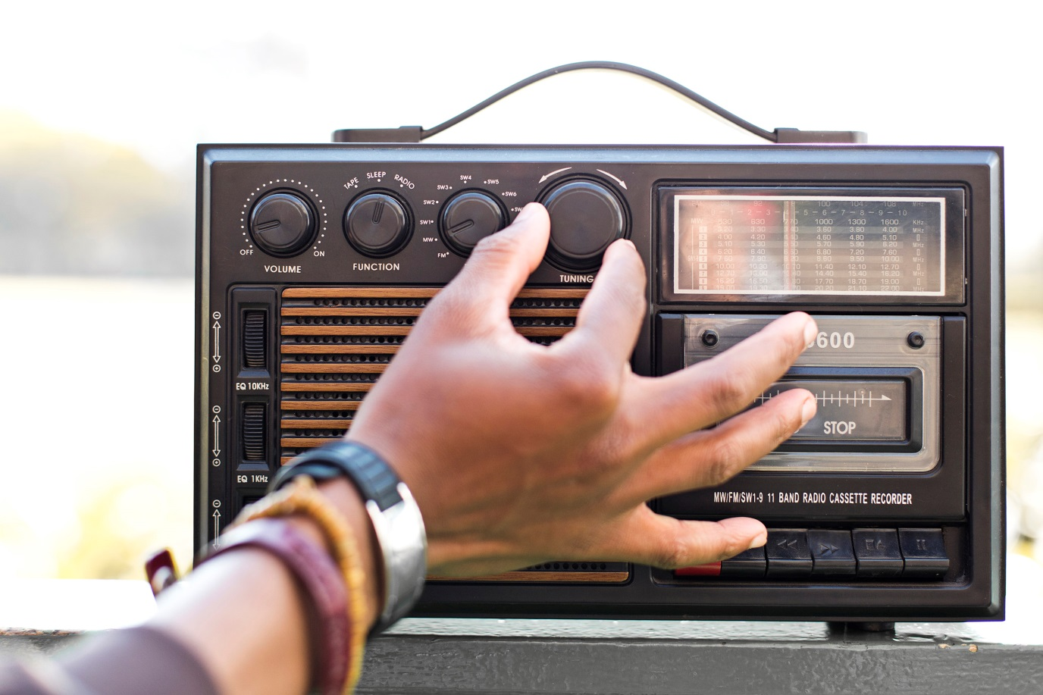
ICASA ACT
Section 4(3)(j) of the Act enables the Authority to may make regulations that are incidental or necessary for the performance of the functions of the Authority
5

Slide 6
Community Broadcasting Services Regulations
Requirements for applicants:
Class Electronic Communications Network Services (CECNS) – Form B
must be registered as a non-profit entity at least two (2) years prior to lodging an application
must demonstrate community development and empowerment with respect to the community
must submit a pre-registration notice with the following documents:
  Various documents - Constitution and Memorandum of Incorporation, tax certificate, reports on management, governance and finance, CVs of board members (including disclosures); business plans, programming plans, etc
  Corporate governance and operational policies, including programming and technical, HR, financial, social media and political branding.
6

Slide 7


CBS Regulations
Things that help granting of a licence:
applicant has never been convicted of offence ito Act / related legislation
ability to fulfil the diverse needs of the community
programming reflects the needs and priorities of the community
contribution towards general enrichment of the lives of community
distinction of the applicant from other applicants and/or broadcasters
demonstration of competency to self-provide, where a licensee chooses to seif-provide for signal distribution
Things that hinder granting of a licence:
registration does not contain the information set out in Form B
supporting documents are missing
registration contains false or misleading information or a misrepresentation of fact
applicant is in contravention of the Act or the related legislation in relation to other licences
an application is made where a community licensee exists with similar services within coverage area
7

Slide 8

CBS Regulations
Governance and Management
Founding documents must reflect defined roles of management and board members
No nepotism on the board – no family members
Board must ensure compliance with all relevant laws, regulations and codes, as well as approve policy, give strategic direction and develop a code of conduct
Station Manager must plan projects to fulfil licence, recruit staff, do training, manage daily operations, ensure that the licensee affiliates with the relevant forums, such as the NAB
The Station Manager must be an ex-officio board member
8

Slide 9
CBS Regulations
Programming
Majority of programmes, news bulletins and current affairs must be local origination programmes
Only 20% can be programme syndication/network and programme sharing
A licensee must have policies dealing with programming matters including:
  mechanisms for community participation
  programming format
  language policy
Community participation
Ownership of the community broadcasting licensee must remain with the community served
Community members must be involved in the management of the community broadcasting licensee
Programming councils/committees - established to enable community participation. Must represent interest groups – youth, woman, people with disabilities
A licensee must submit proof of community participation at every AGM
9

Slide 10

CBS Regulations
Surplus Funding
Surplus funds – utilised and/or invested in the community served for the purposes of community development
Submit annually, a report with supporting documents, detailing how it has utilised or invested the surplus within the financial year
Surplus Funding
In the event of a surplus, funds – utilise and/or invest the funds in the community served for the purposes of community
10

Slide 11

CBS Regulations
Code of Conduct
A licensee must adhere to ICASA’s Code of Conduct for Broadcasters
OR
The BCCSA’s Code of Conduct for Broadcasters, if the licensee is a member of the NAB
11

Slide 12
CBS Regulations
Record Keeping
Licensees must keep all documentation relating to:
founding documentation, details of bank accounts and contracts entered into
details of the board members or trustees including gender, race and address, as well as disclosures of interests of board members
list of capital assets, books of account, financial records and statements
list of donors and details of all financial and non-monetary donations
public file for written complaints received by the licensee, correspondence between the licensee and complainant and a log of telephonic complaints
copies of correspondence with ICASA
a log of:
  programmes broadcasted
  advertisements broadcast and a log of % of air-time / hour allocated to ads
  party election broadcasts broadcast by the licensee
  sponsorship for programmes together with details of payment, financial or otherwise, received for such sponsorship
  all direct and indirect on-air fundraising activities for the stations
12

Slide 13

CBS Regulations
Penalties
If a licence holder fails to:
  ensure that prohibited office bearer isn’t appointed
  ensure that programming aligns with requirements of Regs
  utilise surplus funds for the community
  file and uphold management contracts for the licence
  ensure community participation
  keep adequate records
ICASA can impose penalties of up to 10% of licensee’s annual turnover
13

Slide 14
Digital Sound Broadcasting Services Regulations
In the near future: existing sound broadcasting service licensees will be able to simulcast their existing sound broadcasting programmes on analogue and digital platforms.
At a later stage: consider applicants without existing sound broadcasting licences
DSB technical advisory group (DTAG) to be formed to help the process
Certain digital standards must be adhered to – DRM30, DRM+ and DAB+
Multi-Channel distributors – need ECNS licence and radio frequency spectrum licence in-order to distribute and operate a MUX.
MUX allocation for DSB services is as indicated in the Terrestrial Broadcasting Frequency Plan 2013
14

Slide 15
DSB Regulations
Licensing of DSB Services
A sound broadcasting service licensee must approach the Multi-Channel distributor to confirm available capacity
Licensee must provide written confirmation to ICASA to support its application to provide a DSB service or apply for channel authorisation
ICASA then issues a sound broadcasting service licence to provide DSB services.
The Multi-Channel distributor then grants capacity to the sound broadcasting service licensee
Penalties
Failure to ascertain MUX capacity or apply for DSB services licence
  R200 000.00 for each day of the contravention
Failure to get channel authorisation
  R500 000.00
15

Slide 16

DSB Regulations
Information needed for application
Name of the channel
Nature of channel and its content
The primary language of the channel
The duration of the channel - special event or pop up channel
Confirmation from Multi-Channel distributor of capacity on the MUX
Information regarding the name, nature and content of the existing DSB service provided by the Applicant
16

Slide 17

Current ITP-R
INVITATION TO PRE-REGISTER FOR COMMUNITY SOUND BROADCASTING SERVICE AND RADIO FREQUENCY SPECTRUM LICENCES
Issued: 15 December 2021
Due: 30 June 2022
Criteria to be considered:
  Need, Demand and Support
  Programming
  Business Plan and Funding
  Community Participation & Development
  Technical Viability
  Complete all the relevant forms
  Submit all supporting documents
17

Slide 18

Compliance Report
Community Radio Compliance Reports
  To be submitted to ICASA
    Ensure that license requirements have been adhered to, with a focus on content including:
        news
        talk to music ratio
        local content
        advertising
  DUE: Yesterday, 31 March 2022
18

Slide 19

ICASA
Helpful Contacts at ICASA
    Licensing
      Pascalis Adams – Manager
      PAdams@icasa.org.za
      Compliance
      Busisiwe Mashigo – Manager
      BMashigo@icasa.org.za
19

Slide 20

www.nab.org.za
Email: info@nabsa.co.za
Twitter: @NAB_SouthAfrica
20

